Slide 1
CSE 4255: Telecommunication Lecture 3: Switching

Slide 2
Why Switching?
A network is a set of connected devices. Some of the conventional ways of interconnecting devices are:
Point-to point connection between devices as in a mesh topology.
Connection between a central device and every other device as in star topology.
Bus topology – not practical if the devices are at great distances.
All these techniques require extensive cabling, dependence on a central server or a central bus.
The solution to this interconnectivity problem is switching.

Slide 3
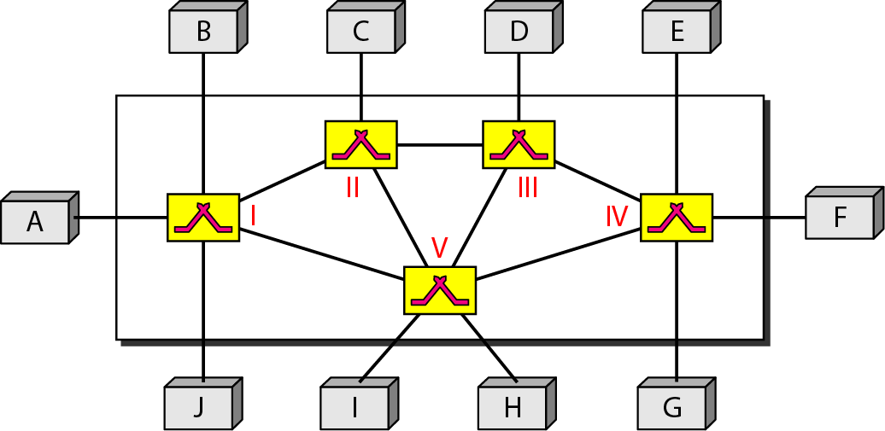
Switching Network:
A switched network consists of a series of interlinked nodes, called switches.
Switches are devices capable of creating temporary connections between two or more devices linked to the switch.
In a switched network, some of these nodes are connected to the end systems (computers or telephones, for example). Others are used only for routing.

Slide 4
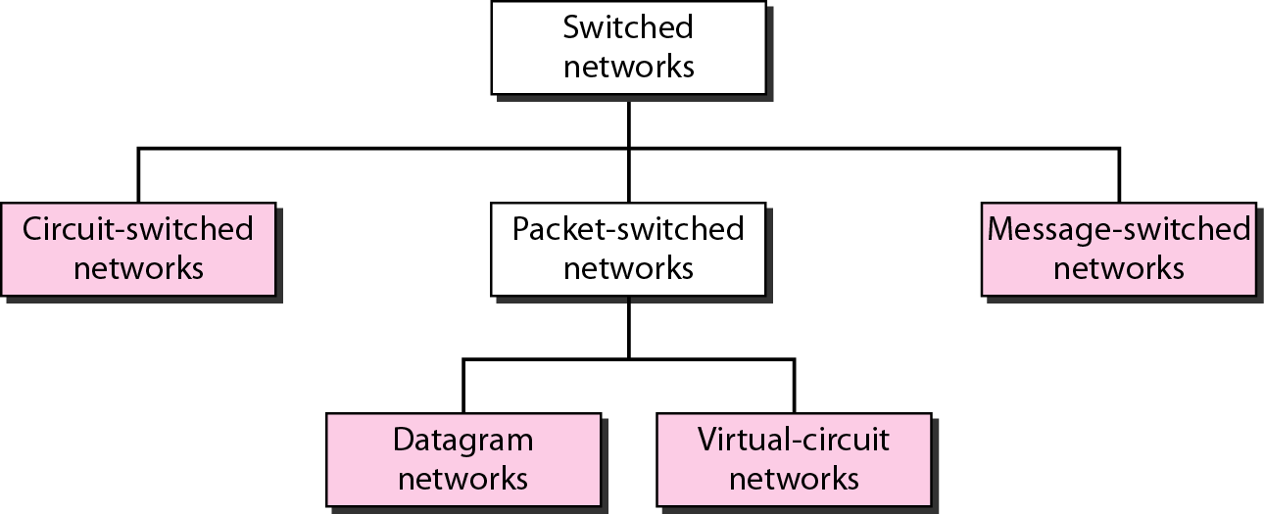
Types of Switching Network:

Slide 5
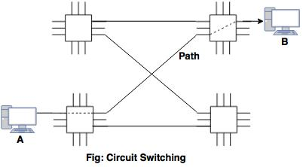
Circuit Switching
Circuit switching takes place at the physical layer.
The actual communication in a circuit-switched network requires three phases: connection setup, data transfer, and connection teardown.
Before starting communication, the stations must make a reservation for the resources to be used during the communication.
Data transferred between the two stations are a continuous flow.
There is no addressing involved during data transfer but there is end-to-end addressing used during the setup phase.

Slide 6
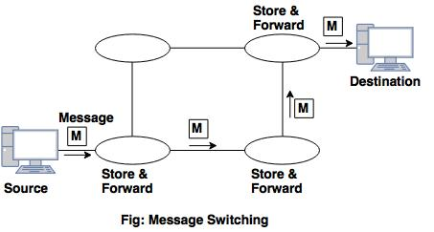
Message Switching
With message switching there is no need to establish a dedicated path between two stations.
When a station sends a message, the destination address is appended to the message.
Each node receives the entire message, stores it in its buffer, and then transmits the message to the next node.
This type of network is called a store-and-forward network.

Slide 7
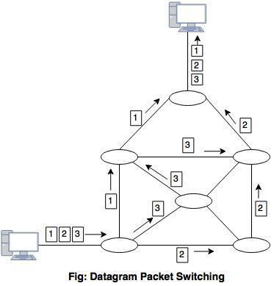
Packet Switching
There are two methods of packet switching: Datagram and virtual circuit.
In both packet switching methods, a message is broken into small parts, called packets.
Each packet is tagged with appropriate source and destination addresses.
With current technology, packets are generally accepted onto the network on a first-come, first-served basis. If the network becomes overloaded, packets are delayed or discarded (``dropped'').
Notes:
Problem: Circuit switching needs call setup time.
Message switching send whole message. It wait for next node available resources.

Slide 8
Circuit Switching (Space-division switch)
In space division switching, the paths in the circuit are separated with each other spatially.
Different ongoing connections, at a same instant of time, uses different switching paths, which are separated spatially.
Some of the space switches are
Crossbar switch
Multi-stage switch

Slide 9
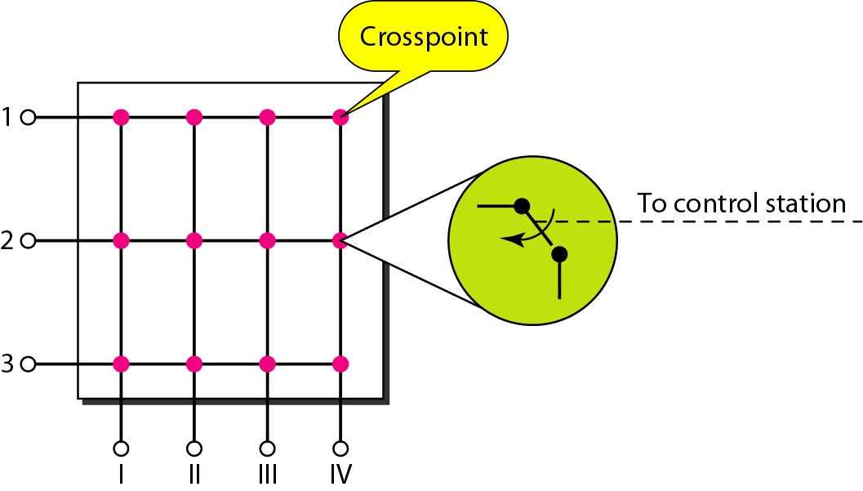
Crossbar Switch
A crossbar switch connects n inputs to m outputs in a grid, using electronic microswitches (transistors) at each crosspoint.
As all the stations are allowed to be connected with all possible connections as long as the called party is free, this Crossbar Switching is called the Non-Blocking.

Slide 10
Limitations
The major limitation of this design is the number of crosspoints required.
To connect n inputs to m outputs using a crossbar switch requires n x m crosspoints.
For example, to connect 1000 inputs to 1000 outputs requires a switch with 1,000,000 crosspoints.
A crossbar with this number of crosspoints is impractical.
Such a switch is also inefficient because statistics show that, in practice, fewer than 25 percent of the crosspoints are in use at any given time. The rest are idle.

Slide 11
Multistage Switch-Why?
The solution to the limitations of the crossbar switch is the multistage switch, which combines crossbar switches in several (normally three) stages.
In a single crossbar switch, only one row or column (one path) is active for any connection. So we need N x N crosspoints.
If we can allow multiple paths inside the switch, we can decrease the number of crosspoints.
Each crosspoint in the middle stage can be accessed by multiple crosspoints in the first or third stage.

Slide 12
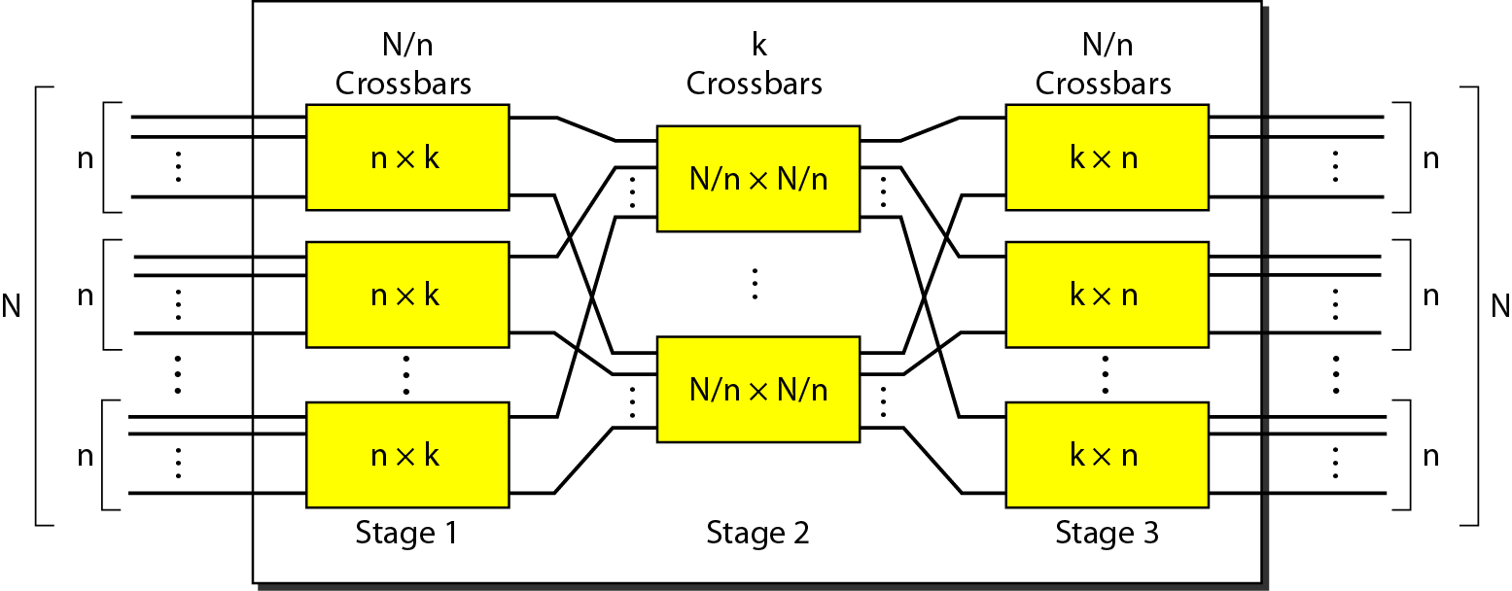
Multistage Switch Structure
To design a three-stage switch, we follow these steps:
We divide the N input lines into groups, each of n lines. For each group, we use one crossbar of size n x k, where k is the number of crossbars in the middle stage. In other words, the first stage has N/n crossbars of n x k crosspoints.
We use k crossbars, each of size (N/n) x (N/n) in the middle stage.
We use N/n crossbars, each of size k x n at the third stage.
We can calculate the total number of crosspoints as follows:
N/n ( n x k ) + k ( N/n x N/n ) + N/n ( n x k ) = 2kN + k(N/n)²

Slide 13
Example: Multistage Switch
Design a three-stage, 200 × 200 switch (N = 200) with k = 4 and n = 20.
Solution
In the first stage we have N/n or 10 crossbars,
each of size 20 × 4.
In the second stage, we have 4 crossbars,
each of size 10 × 10.
In the third stage, we have 10 crossbars,
each of size 4 × 20.
The total number of crosspoints is 2kN + k(N/n)², or 2000 crosspoints.
This is 5 percent of the number of crosspoints in a single-stage switch
(200 × 200 = 40,000).

Slide 14
Blocking or Non-blocking
Blocking
Blocking refers to times when one input cannot be connected to an output because there is no path available between them-all the possible intermediate switches are occupied.
In a single-stage switch, blocking does not occur because every combination of input and output has its own crosspoint; there is always a path.
In a multistage switch, The small number of crossbars at the middle stage creates blocking; if k < n , the switch is blocked.
Non-blocking
Non-blocking permits all stations to connect (in pairs) at once.
Clos investigated the condition of nonblocking in multistage switches and came up with the following formula.
According to the Clos criterion: n = (N/2)^{1/2}
k > =2n – 1

Slide 15
Example- Non-blocking
Redesign the previous three-stage, 200 × 200 switch, using the Clos criteria with a minimum number of crosspoints.
Solution
We let n = (200/2)^{1/2}, or n = 10.
We calculate k = 2n − 1 = 19.
In the first stage, we have 200/10, or 20, crossbars,
each with 10 × 19 crosspoints.
In the second stage, we have 19 crossbars,
each with 20 × 20 crosspoints.
In the third stage, we have 20 crossbars
each with 19 × 10 crosspoints.
The total number of crosspoints is
20(10 × 19) + 19(20 × 20) + 20(19 ×10) = 15200.

